Slide 1







Data Wrangling

Slide 2


Data Wrangling
Notes:
First you must import your data into R. This typically means that you take data stored in a file, database, or web application programming interface (API), and load it into a data frame in R. If you can’t get your data into R, you can’t do data science on it!
Once you’ve imported your data, it is a good idea to tidy it. Tidying your data means storing it in a consistent form that matches the semantics of the dataset with the way it is stored. In brief, when your data is tidy, each column is a variable, and each row is an observation. Tidy data is important because the consistent structure lets you focus your struggle on questions about the data, not fighting to get the data into the right form for different functions.
Once you have tidy data, a common first step is to transform it. Transformation includes narrowing in on observations of interest (like all people in one city, or all data from the last year), creating new variables that are functions of existing variables (like computing speed from distance and time), and calculating a set of summary statistics (like counts or means).
Together, tidying and transforming are called wrangling, because getting your data in a form that’s natural to work with often feels like a fight!
From R4DS

Slide 3

dplyr
dplyr is a grammar of data manipulation
Collection of functions (verbs) used to manipulate data frames:
filtering out certain rows or sorting your data
calculating new columns based on existing columns
grouping and summarizing data
combining data together

Slide 4
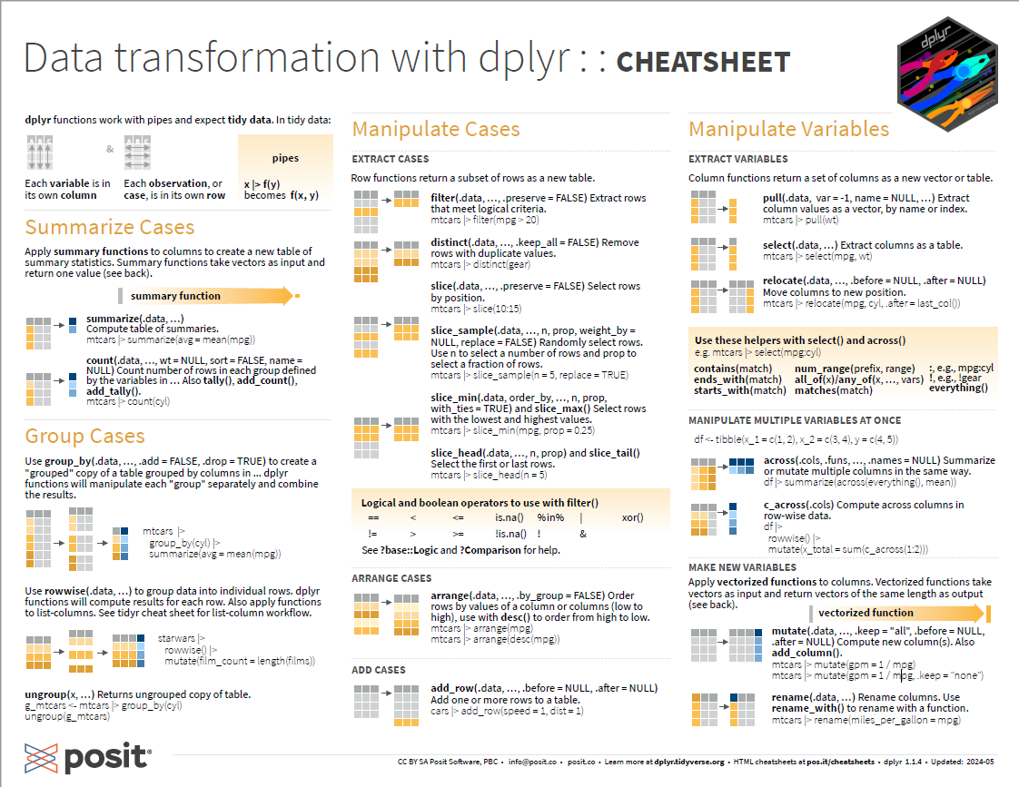

Slide 5
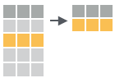
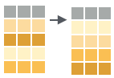
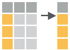
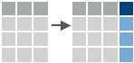
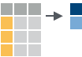
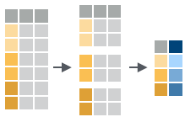
dplyr verbs
> filter() – Keep rows that match a condition > arrange() – Order rows using column values
> select() – Keep or drop columns by name and types
> mutate() – Create, modify, and delete columns
> summarize() – Summarize each group down to one row
> group_by() – Group by one or more variables

Slide 6
dplyr verbs
the first argument is always a data frame
subsequent arguments tell the verb() what to do
output is always a new data frame
each verb does one specific thing well, so we often want to chain multiple verbs together.
the pipe operator %>% comes in handy for chaining multiple operations together

Slide 7
pipe %>%
The pipe helps make code more readable
Structures operations left-to-right rather than as nested functions
Everything to the left of the pipe is passed as the first argument to the function on the right
X %>% f() is equivalent to f(X)
X %>% f(y) is equivalent to f(X, y)
X %>% f() %>% g() %>% h() is equivalent to h(g(f(X)))
*Base R pipe |> is equivalent to %>%
Notes:
Allows code to read more naturally as a sentence.
The name magrittr is a playful reference to René Magritte, the Belgian surrealist artist — best known for his painting “The Treachery of Images”, which features a pipe and the caption:
"Ceci n’est pas une pipe" ("This is not a pipe")
This painting famously reminds viewers that the image of a pipe is not the same as a real pipe.

Slide 8
pipe %>%
Think of the following sequence of actions – find keys, unlock car, start car, drive to work, park.
As a set of nested R functions this would look like:
Using pipes gives it a more natural (and easier to read) structure
> park(drive(start_car(unlock_car(find("keys"))), to = "work"))
> find("keys") %>% unlock_car() %>% start_car() %>% drive(to = "work") %>% park()
> find("keys") |> unlock_car() |> start_car() |> drive(to = "work") |> park()
Notes:
Not to be confused with the + sign we used in ggplot(). In ggplot the + sign is adding layers. The pipe is directional and moves the object from the left to the first argument in the function to the right.

Slide 9
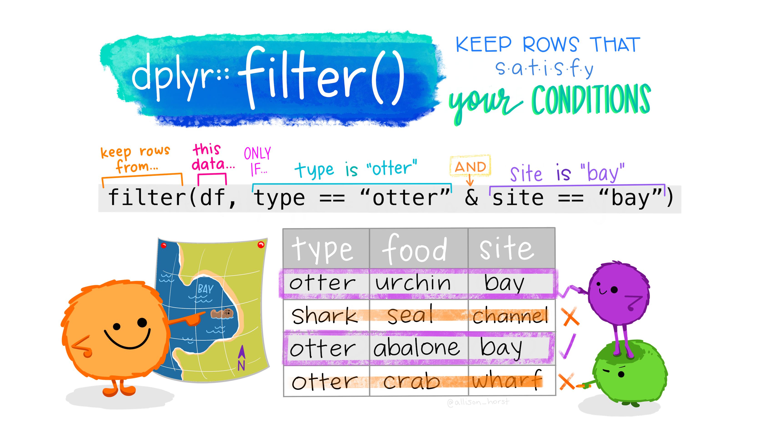
- subset your data
> filter()
Artwork by @allison_horst

Slide 10
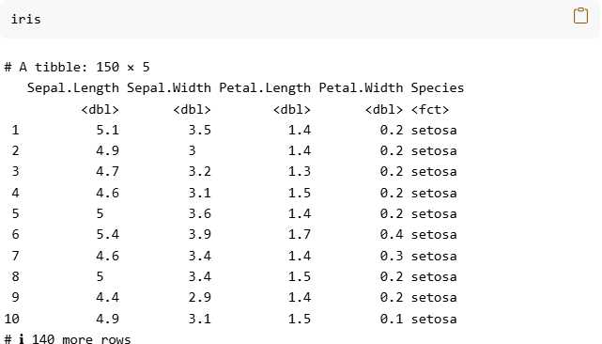
- subset your data
> filter()
Notes:
Iris Dataset

Slide 11
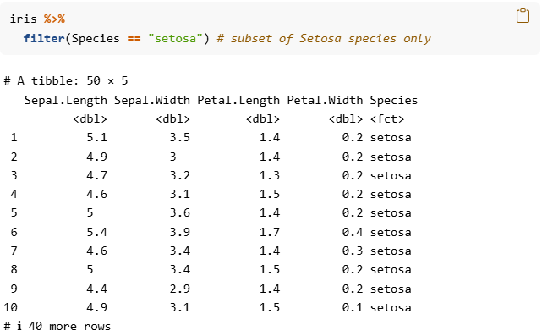
- subset your data
> filter()
Notes:
Filter by a species . Here we choose a subset of just Setosa. Notice the number of rows went from 150 to 50.

Slide 12
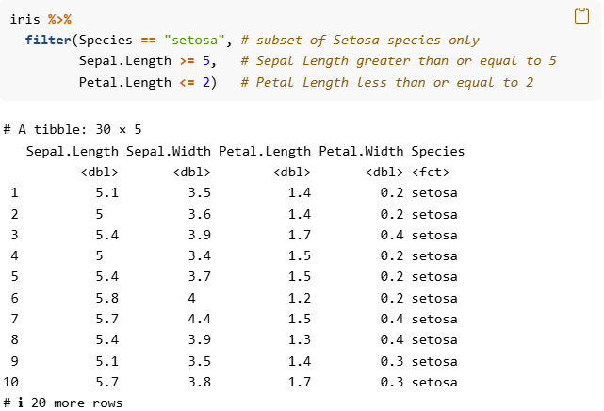
- subset your data
> filter()
Notes:
Filter by species again, but now also filtering by sepal.length and petal length. Now a subset of 30 observations.

Slide 13
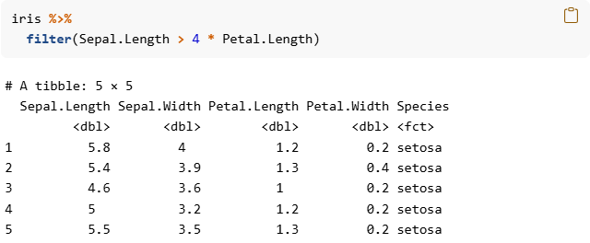
- subset your data
> filter()
Notes:
Condition can be calculated based on another column.
Filtering observations where Sepal.Length is at least 4 times longer than petal length

Slide 14
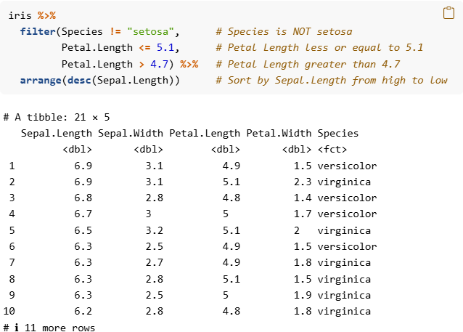
- subset your data
> filter()
Notes:
More complex. Filtering by species, Everything that is NOT setosa. Petal length is in between 4.7 and 5.1. And then we pipe that table into the arrange() function and sort it based on Sepal. Length. Desc() means high to low. If we did not have the desc() option it would be low to high which is the default.

Slide 15
- subset your data
> filter()
Operator | Definition | Example
< | Less than | x < y
<= | Less than or equal to | x <= y
> | Greater than | x > y
>= | Greater than or equal to | x >= y
== | Equal to | x == y
!= | NOT equal to | x != y
is.na() | Test if x is NA | is.na(x)
%in% | Group membership | x %in% y
| | OR | x | y
& | AND | x & y
Notes:
X is your column name. y can be numeric, a character / factor. We could do something like, subsetting observations where Species == trout OR length > 500

Slide 16
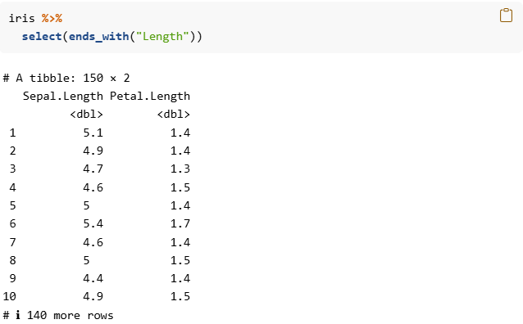
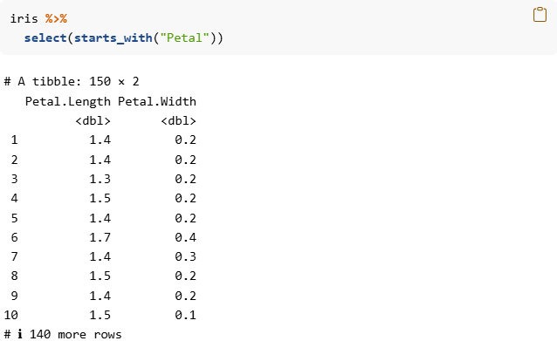
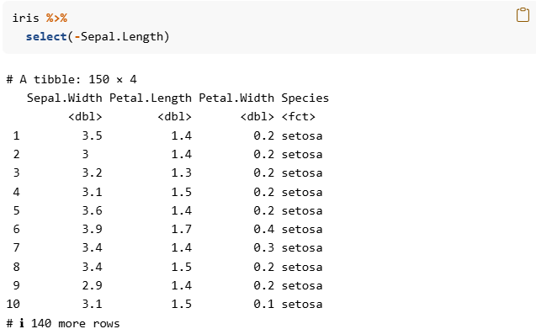
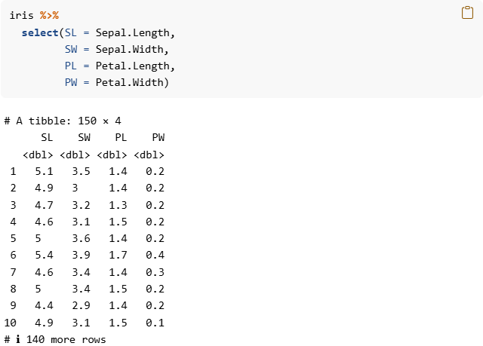
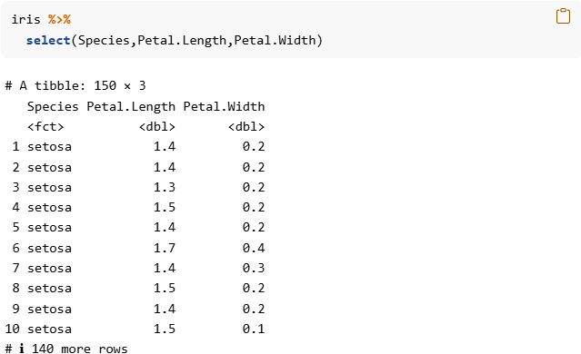
- subset columns
> select()
Notes:
Iris dataset

Slide 17
- subset columns
> select()
Notes:
Select a subset of the columns we want to KEEP

Slide 18
- subset columns
> select()
Notes:
Use the minus sign to select the columns we do not want to keep!

Slide 19
- subset columns
> select()
Notes:
We can select and rename the columns

Slide 20
- subset columns
> select()
Notes:
Helper functions. We can specify columns that start with something

Slide 21
- subset columns
> select()
Notes:
Select columns that end with something

Slide 22
- helpers
> select()
starts_with(): Starts with a prefix
ends_with(): Ends with a suffix
contains(): Contains a literal string
num_range(): Matches a numerical range like x01, x02, x03
one_of(): Matches variable names in a character vector
everything(): Matches all variables
last_col(): Select last variable, possibly with an offset
matches(): Matches a regular expression (a sequence of symbols/characters expressing a string/pattern to be searched for within text)

Slide 23
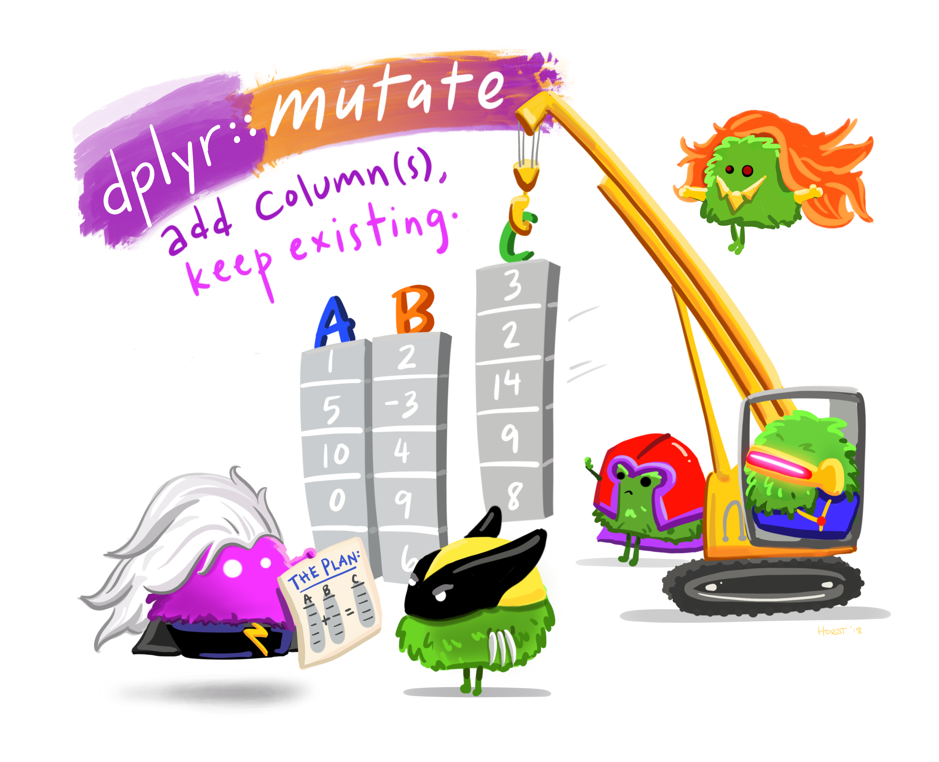
- add new columns
> mutate()
Artwork by @allison_horst

Slide 24
- add new columns
> mutate()

Slide 25
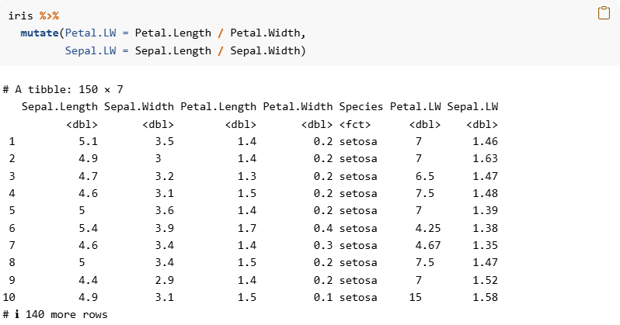
- add new columns
> mutate()
Notes:
Create two new columns that are the ratio of Length / Width. Appends to the end of the dataframe

Slide 26
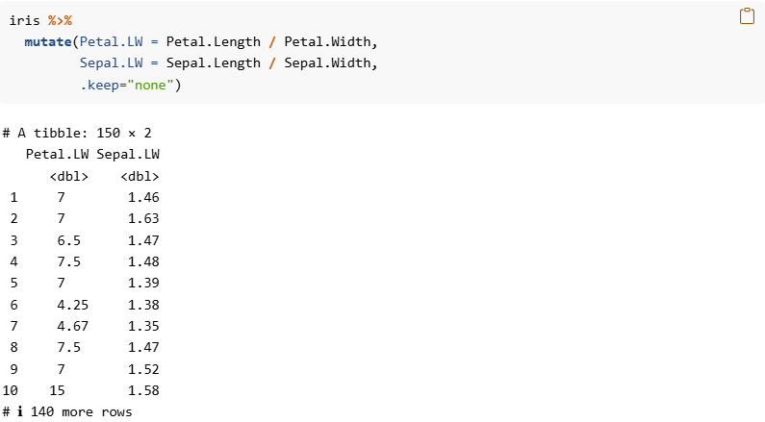
- add new columns
> mutate()
Notes:
Options to drop all of the original columns. Here .keep = “none”. Options for dplyr verbs begin with a “ . “ Its often more readable to just use the select function to explicitly specify the columns you want.

Slide 27
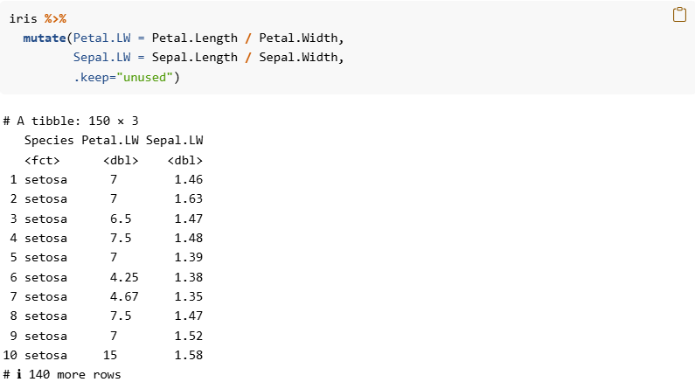
- add new columns
> mutate()

Slide 28
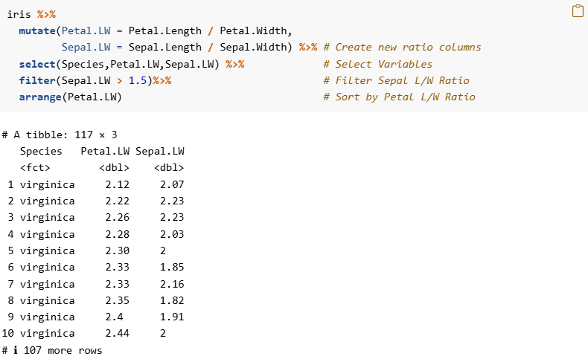
- add new columns
> mutate()
Notes:
Tie it all together. First we create two new variables based on the L / W ratios. Then we select the variables columns we are interested in. We filter out observations (rows) where Sepal ratio is greater than 1.5 Then we arrange based on Petal ratio from smallest to largest.

Slide 29
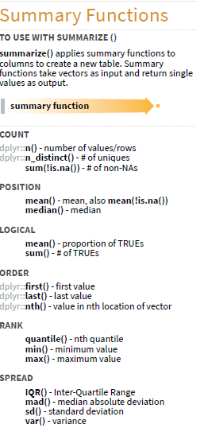
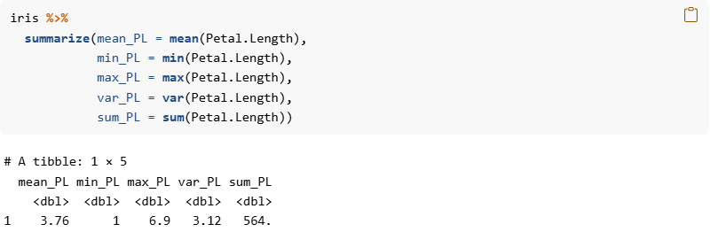
- summary statistics
> summarize()
Notes:
Here we calculate various summary statistics. Lots of functions you can use, which are applied to the columns and returns a single value. Most often combined with the group_by Function

Slide 30
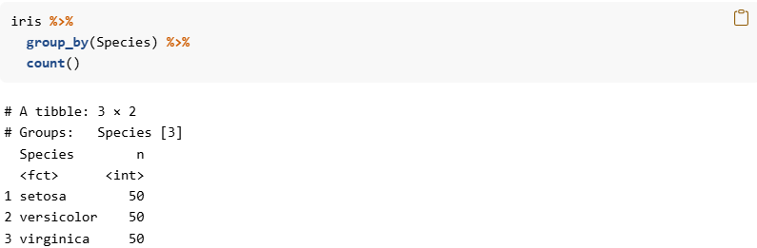
- grouped summaries
> group_by()
Notes:
Here we create a table for number of times each species is observed. Useful for creating frequency tables. We can group by multiple variables, such as species and island. Or by species and sex. When you use multiple variables in the group_by() function, each combination of those variables will be grouped.

Slide 31
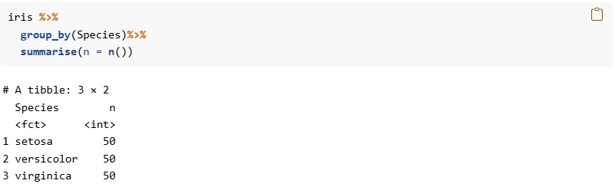
- grouped summaries
> group_by()
Notes:
Another way to do the same thing using the summarize function. Here n is the name of the column we specify, and n() is the function to count.

Slide 32
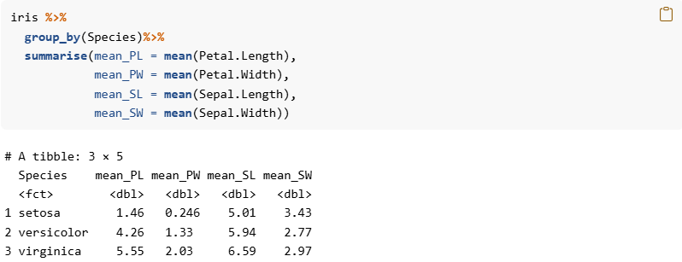
- grouped summaries
> group_by()
Notes:
We can group by the species, and calculate means for each of our variables. Before we returned the grand mean for each of those column variables, now we are calculating them separately for each species.

Slide 33
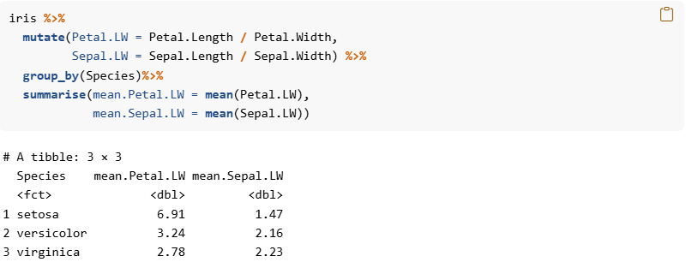
- grouped summaries
> group_by()
Notes:
Tying it all together. We can calculate a new variable (column), and then perform the grouped summaries.

Slide 34
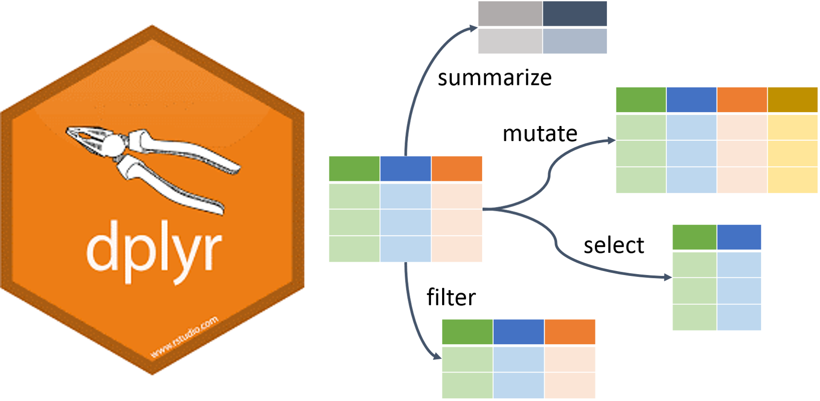
Your Turn 1
Open the DataManipulation.Rmd
First step is to load your packages and data.
📑 use the dplyr cheat sheet or `?help` function in R 🤚feel free to ask any questions

Slide 35
*_join - Combining datasets
There are two main types of joining
Mutating joins – add variables from one data frame to another based on matching characteristics between the two
Filtering joins – subset one data frame based on matching characteristics with another data frame

Slide 36
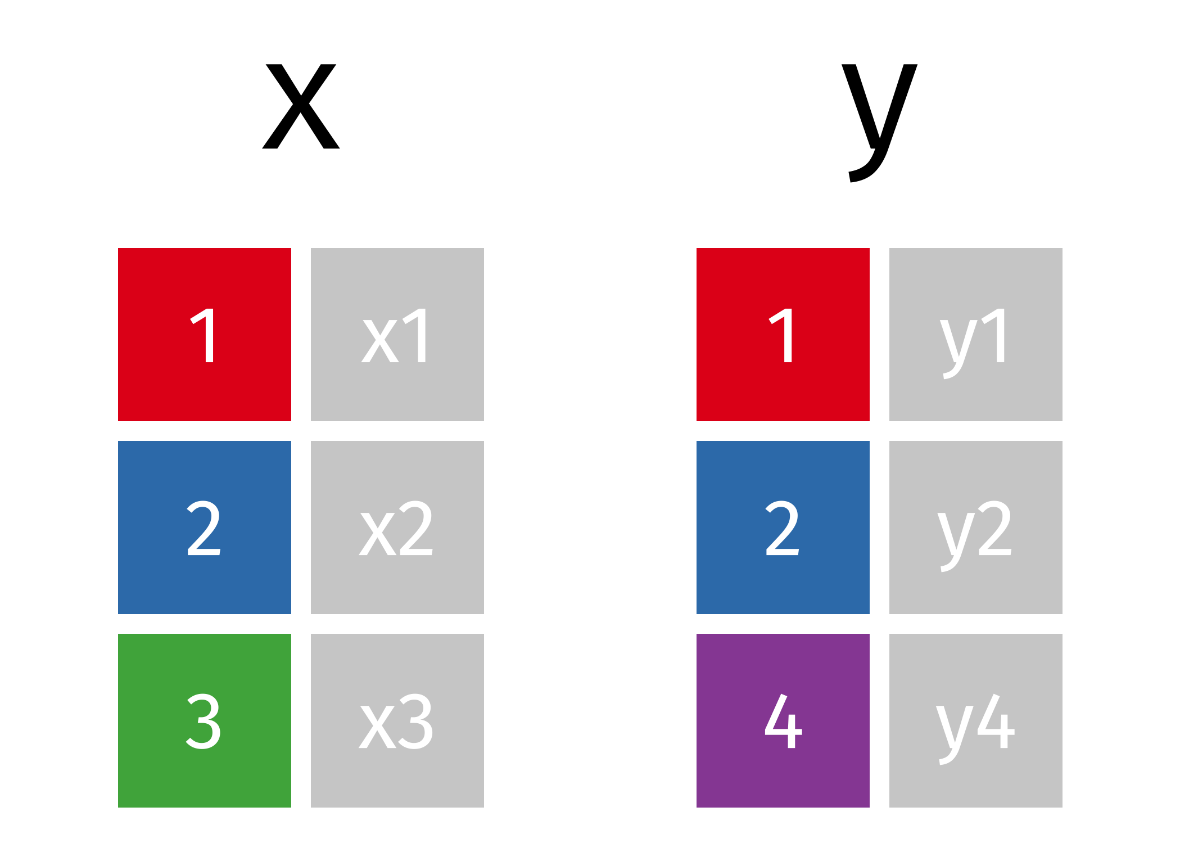
*_join - Combining datasets
x
#> # A tibble: 3 × 2
#> id x
#> <int> <chr>
#> 1 x1
#> 2 x2
#> 3 x3
y
#> # A tibble: 3 × 2
#> id y
#> <int> <chr>
#> 1 y1
#> 2 y2
#> 4 y4

Slide 37
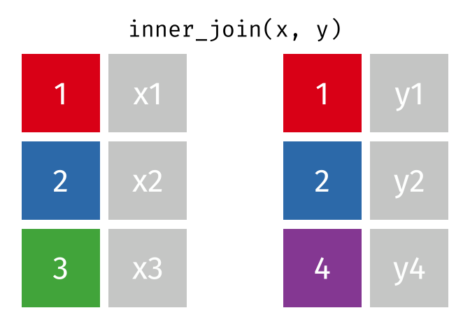
inner_join(x , y)
inner_join(x, y, by = "id")
#> # A tibble: 2 × 3
#> id x y
#> <int> <chr> <chr>
#> 1 x1 y1
#> 2 x2 y2
All rows from x where there are matching values in y, and all columns from x and y.
Notes:
All rows from x where there are matching values in y, and all columns from x and y.

Slide 38

left_join(x , y)
left_join(x, y, by = "id")
#> # A tibble: 3 × 3
#> id x y
#> <int> <chr> <chr>
#> 1 x1 y1
#> 2 x2 y2
#> 3 x3 <NA>
All rows from x, and all columns from x and y. Rows in x with no match in y will have NA values in the new columns.
Notes:
All rows from x, and all columns from x and y. Rows in x with no match in y will have NA values in the new columns.

Slide 39

right_join(x , y)
right_join(x, y, by = "id")
#> # A tibble: 3 × 3
#> id x y
#> <int> <chr> <chr>
#> 1 x1 y1
#> 2 x2 y2
#> 4 <NA> y4
All rows from y, and all columns from x and y. Rows in y with no match in x will have NA values in the new columns.
Notes:
All rows from y, and all columns from x and y. Rows in y with no match in x will have NA values in the new columns.

Slide 40
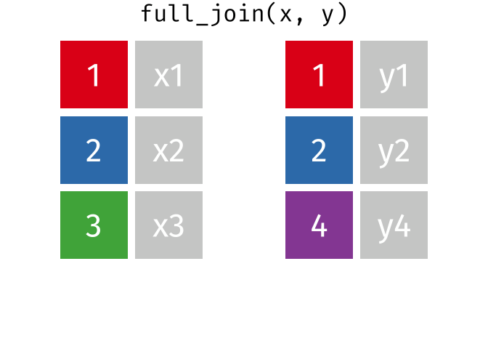
full_join(x , y)
full_join(x, y, by = "id")
#> # A tibble: 4 × 3
#> id x y
#> <int> <chr> <chr>
#> 1 x1 y1
#> 2 x2 y2
#> 3 x3 <NA>
#> 4 <NA> y4
All rows and all columns from both x and y. Where there are not matching values, returns NA for the one missing.
Notes:
All rows and all columns from both x and y. Where there are not matching values, returns NA for the one missing.

Slide 41

semi_join(x , y)
semi_join(x, y, by = "id")
#> # A tibble: 2 × 2
#> id x
#> <int> <chr>
#> 1 x1
#> 2 x2
All rows from x where there are matching values in y, keeping just columns from x.
Notes:
Filtering join, creating a subset - All rows from x where there are matching values in y, keeping just columns from x.

Slide 42

anti_join(x , y)
anti_join(x, y, by = "id")
#> # A tibble: 1 × 2
#> id x
#> <int> <chr>
#> 3 x3
All rows from x where there are not matching values in y, keeping just columns from x.
Notes:
All rows from x where there are not matching values in y, keeping just columns from x.

Slide 43
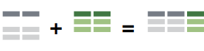


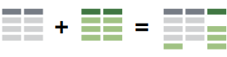

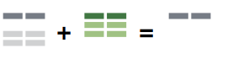
*_join : Recap
inner_join() retains only cases in both data sets left_join() retains all cases in left data set right_join() retains all cases in right data set full_join() retains all cases in either data set semi_join() extracts cases that have a match anti_join() extracts cases that do not have a match
Remaster the Tidyverse

Slide 44
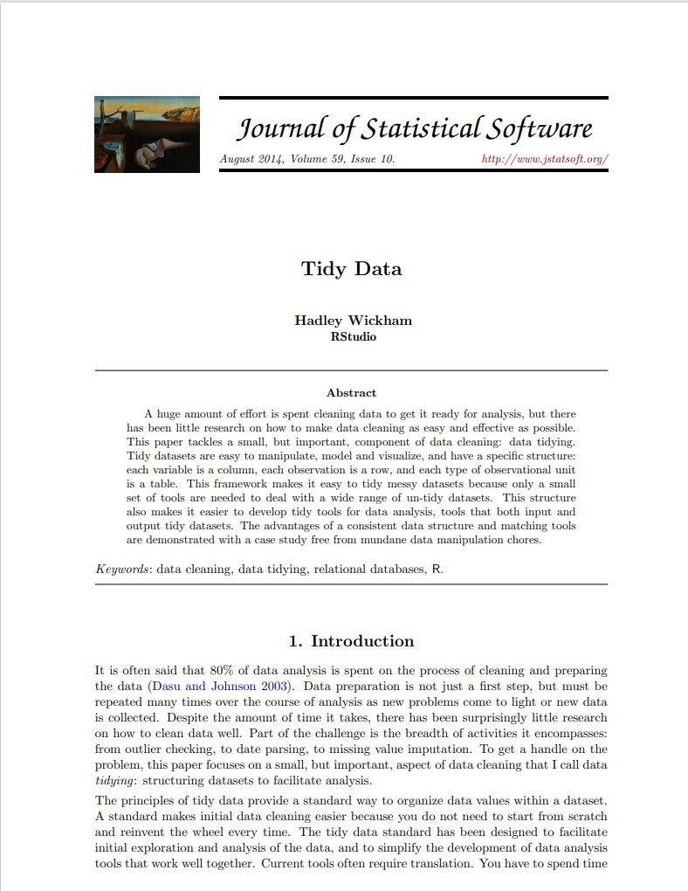
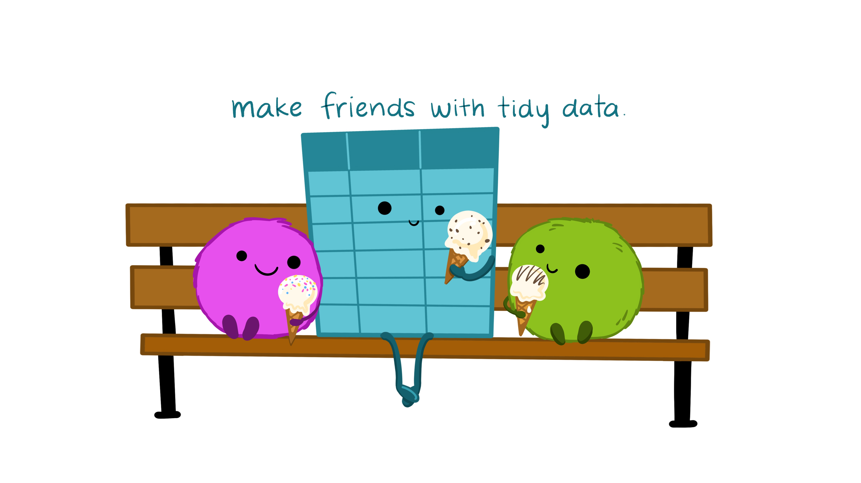
Tidy data
“ Tidy datasets are all alike, but every messy dataset is messy in its own way ”
–Hadley Wickham
Illustrations from the Openscapes blog Tidy Data for reproducibility, efficiency, and collaboration by Julia Lowndes and Allison Horst

Slide 45
Tidy data – same data 4 ways
Table 2:
country | year | type | count
Afghanistan | 1999 | cases | 745
Afghanistan | 1999 | population | 19987071
Afghanistan | 2000 | cases | 2666
Afghanistan | 2000 | population | 20595360
Brazil | 1999 | cases | 37737
Brazil | 1999 | population | 172006362
Brazil | 2000 | cases | 80488
Brazil | 2000 | population | 174504898
China | 1999 | cases | 212258
China | 1999 | population | 1272915272
China | 2000 | cases | 213766
China | 2000 | population | 1280428583
Table 1:
country | year | cases | population
Afghanistan | 1999 | 745 | 19987071
Afghanistan | 2000 | 2666 | 20595360
Brazil | 1999 | 37737 | 172006362
Brazil | 2000 | 80488 | 174504898
China | 1999 | 212258 | 1272915272
China | 2000 | 213766 | 1280428583
Notes:
You can represent the same underlying data in multiple ways. The next two slides show the same data organized in four different ways. Each dataset shows the same values of four variables country, year, population, and cases, but each dataset organizes the values in a different way. Subset of TB dataset to show how data can be shown in a variety of ways.

Slide 46
Tidy data – same data 4 ways
Table 4a: cases
country | 1999 | 2000
Afghanistan | 745 | 2666
Brazil | 37737 | 80488
China | 212258 | 213766
Table 3: rate = cases / population
country | year | rate
Afghanistan | 1999 | 745/19987071
Afghanistan | 2000 | 2666/20595360
Brazil | 1999 | 37737/172006362
Brazil | 2000 | 80488/174504898
China | 1999 | 212258/1272915272
China | 2000 | 213766/1280428583
Table 4b: population
country | 1999 | 2000
Afghanistan | 19987071 | 20595360
Brazil | 172006362 | 174504898
China | 1272915272 | 1280428583
Notes:
Subset of TB dataset to show how data can be shown in a variety of ways.

Slide 47
Tidy data – same data 4 ways
Each column is a variable
country | year | cases | population
Afghanistan | 1999 | 745 | 19987071
Afghanistan | 2000 | 2666 | 20595360
Brazil | 1999 | 37737 | 172006362
Brazil | 2000 | 80488 | 174504898
China | 1999 | 212258 | 1272915272
China | 2000 | 213766 | 1280428583
Each row is an observation
Each cell is a value

Slide 48


Slide 49
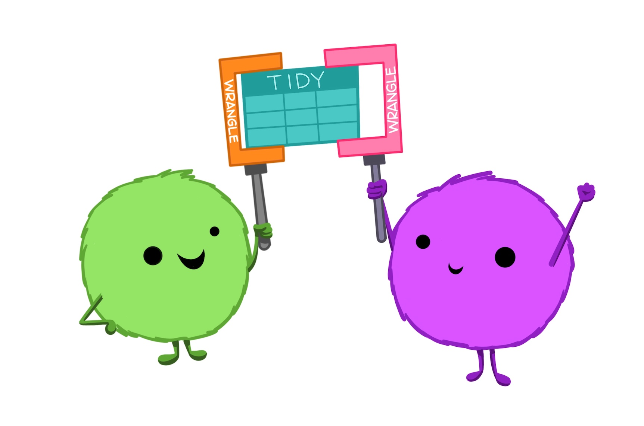
tidyr
tidyr is a package in tidyverse to help tidy your data
Pivoting – going between wide and long data formats
Splitting and combining character columns
Nesting and unnesting columns
Clarifying how NAs should be treated
Illustrations from the Openscapes blog Tidy Data for reproducibility, efficiency, and collaboration by Julia Lowndes and Allison Horst

Slide 50

tidyr

Slide 51
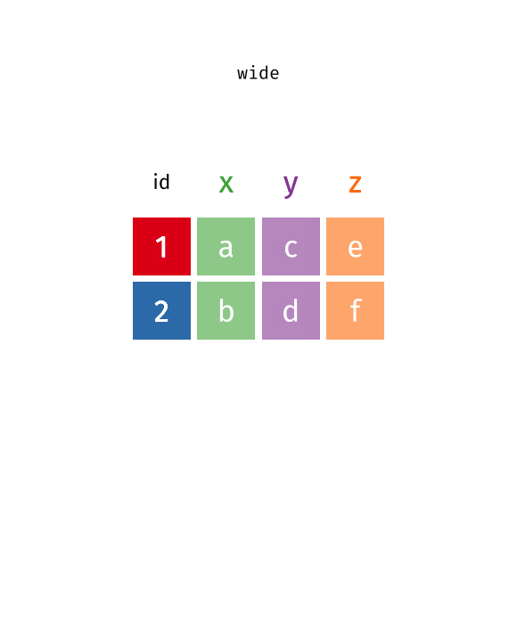
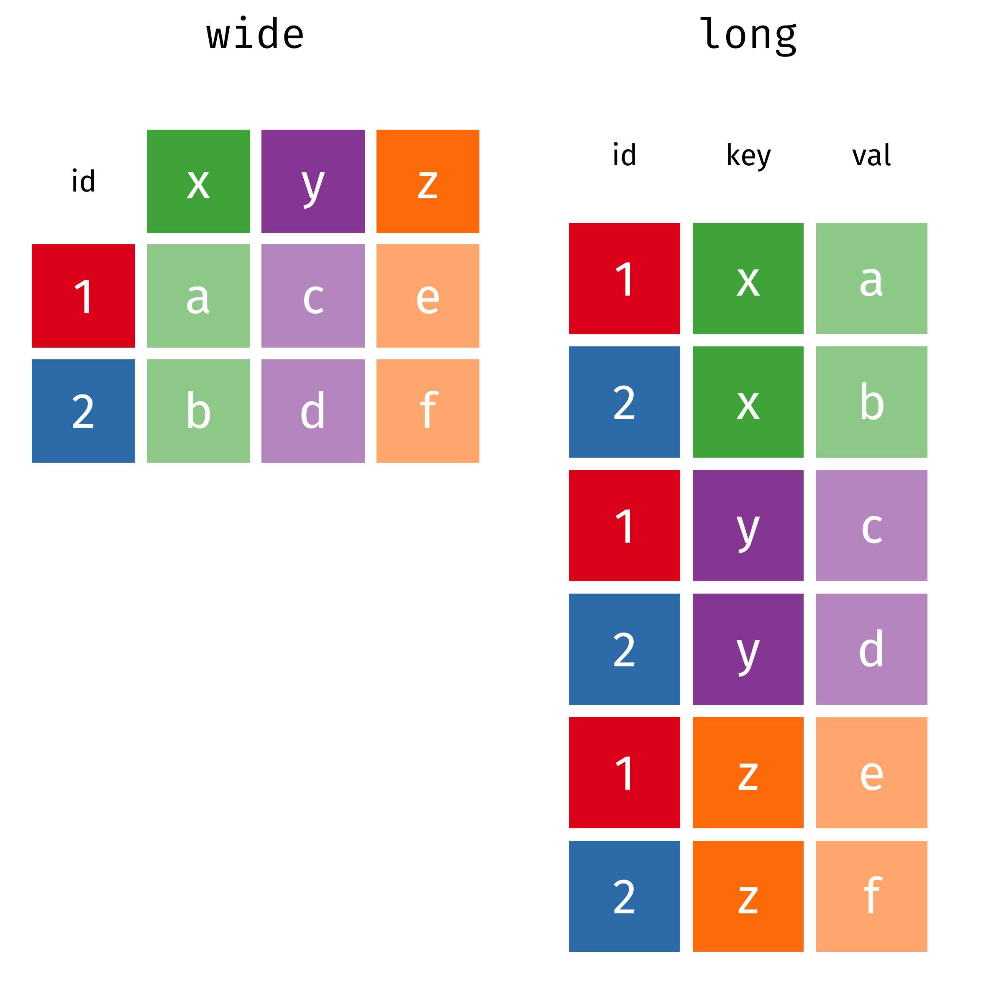
tidyr
pivot_wider(data, names_from = key, values_from = val)
pivot_longer(data, cols = x:z, names_to = "key", values_to = "val")
Notes:
Wide is generally not “tidy”. Here the column names are values. Wide is easy to read as summary tables in reports, but not great for coding with.
From wide to long – Specify which column names will now be values. Specifcy what the values will now be called, values_to =“val” , specify what the column will now be names_to “key”.
From long to wide – where will the column names come from, here its “key”, values will come from “val”.

Slide 52
Your turn 2
Navigate the Your turn 2 in the DataManipulation.Rmd
There are some examples of pivoting data frame and other tidyr functions for cleaning data.
At the end there is an example dataset to convert fish encounters from long to wide format. 📑 use the tidyr cheat sheet or `?help` function in R 🤚feel free to ask any questions

Slide 53
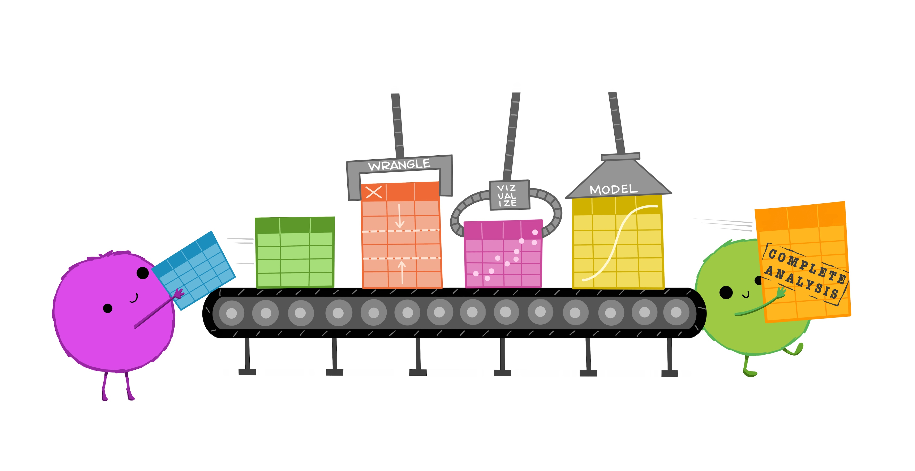
readr – importing data
Illustrations from the Openscapes blog Tidy Data for reproducibility, efficiency, and collaboration by Julia Lowndes and Allison Horst

Slide 54
But First! Some computer review
Spending time at the outset thinking about folder structure and data setup will save you LOTS of time later on. So we’ll review:
Folder structure – Where IS it?
Data Organization – Is it clear?
Benefits of tidy data
Computer Review!

Slide 55
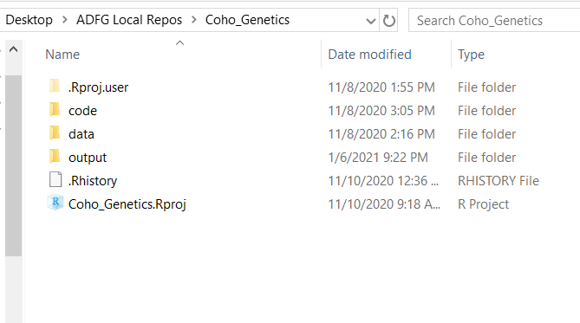
Folder Structure
It is very helpful to standardize your structure
Under your main project folder, use one .Rproj for that group of analyses. Use folders named:
data
code (or “analysis”)
output
etc.

Slide 56

Folders (Directories)
What is a directory?
Using modern tools in R (like RProjects!) avoids many of the headaches with directories; regardless, it’s important to be aware of these issues.
Before importing your data, you should know where R thinks you are
somewhere on
your computer

Slide 57
Where AM I?! (Directory Location)
Use getwd() to see what folder R is currently set to
Type file.choose() to see the exact location of a file
Click the file you’d like, it will print file location to the console
When using RProjects, we can use relative file paths:
Where am I?
Full file path: C:/Users/jtpriest/ADFG_R_Intro_Workshop/code/2_First_script.R
Relative file path: code/2_First_script.R
Notes:
No matter where we have the course folder saved, we all share the same “relative path” with respect to the course folder.

Slide 58
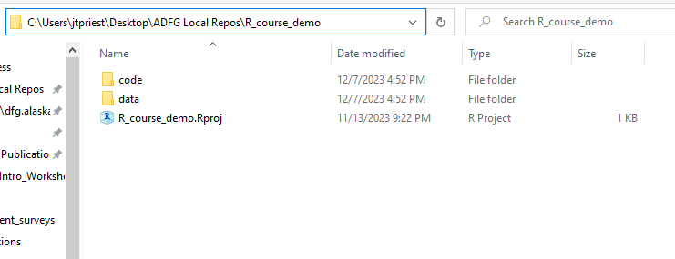
Folders & RProjects
RProjects set your directory to the location of where the .Rproj file is located. This is VERY useful!
If you have a file in folder data like to the right, what happens if you write:
read_csv(“input.csv”)
It can’t find the file. Change this to
read_csv(“data/input.csv”)
This would also work:
read_csv(“C:/Users/jtpriest/Desktop/ADFG Local Repos/R_course_demo/data/input.csv”)

Slide 59




Data
Data should be:
Machine Readable – easily imported
Unsummarized & Raw – try not to edit it before importing into R
Untabled – Use “long” format (lots of rows) e.g., each row being a year & species
Tidy – Each column is a variable; each row an observation; every cell a single value
Notes:
Minimize editing – One master file that all work is done from. Not several versions of the same data.

Slide 60
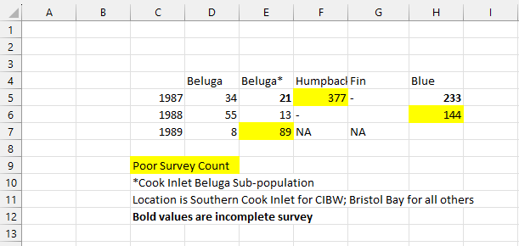
“Machine Readable”
Important data import point! We will be importing data to a machine, so think like one. What are some problems with importing this data?
Notes:
Highlights, Special Characters, inconsistent NA, 0s, Missing data etc. Meta data. Which column do they get assumed to be? Not tidy. Not starting in cell A1. R will read two blank cells to begin with and unsure what the headers are.

Slide 61
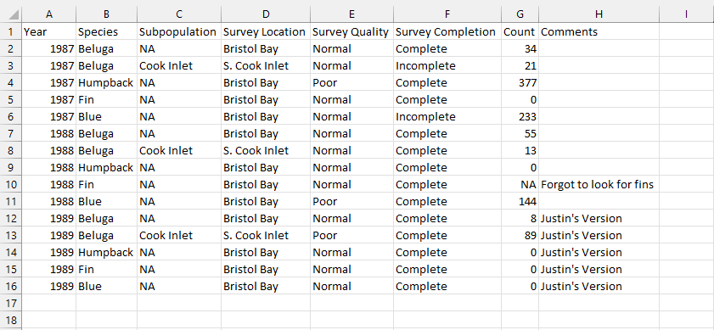
Machine Readable
Don’t use color/formatting; have columns for variables; don’t have hidden data; be consistent about blanks vs NA vs 0; start at cell A1
Notes:
Starting at A1, column names, NAs for missing, and 0s instead of blanks.

Slide 62
Unsummarized and untabled
River | Length
Kenai | 560
Kenai | 610
Kenai | 575
Taku | 565
Taku | 585
Data that are already summarized can’t have stats. Raw is best!
“Tabled” data is a form of summarizing and isn’t tidy (more on this in a second!)
River | Count | Ave Len
Kenai | 3 | 581.6
Taku | 2 | 575
Year | Species | Count
2022 | Coho | 3
2022 | King | 5
2023 | Coho | 8
2023 | King | 11
 | Coho | King
2022 | 3 | 5
2023 | 8 | 11
Notes:
What if you wanted to calculate min, max, standard deviations? Tabled, easy to read from in publications. Not easy to work with in R.

Slide 63
Tidy Data
year | river | species | count
2007 | Kenai | burbot | 5
2007 | Susitna | burbot | 9
2007 | Susitna | sucker | 3
2008 | Kenai | burbot | 6
2008 | Susitna | burbot | 8
2008 | Susitna | sucker | 3
year | river | species | count
2007 | Kenai | burbot | 5
2007 | Susitna | burbot | 9
2007 | Susitna | sucker | 3
2008 | Kenai | burbot | 6
2008 | Susitna | burbot | 8
2008 | Susitna | sucker | 3
year | river | species | count
2007 | Kenai | burbot | 5
2007 | Susitna | burbot | 9
2007 | Susitna | sucker | 3
2008 | Kenai | burbot | 6
2008 | Susitna | burbot | 8
2008 | Susitna | sucker | 3
Each column is a variable
Each row is an observation
Each cell is a value

Slide 64

Why be Tidy?
Though Excel is quick, it can give us bad habits
By using tidy data, we can:
Add comments to each observation
Easily pair a variable to new data
Ensure all observations are of same type & structure
This WILL save you time later
Who cares?!
Notes:
Pair or join

Slide 65
Data Do’s & Data Don’ts
Use unsummarized data (if possible)
To the extent possible, do cleanup in R so that if you re-download from your database (e.g., OceanAK) you don’t have to spend time changing things
Starting out, you can “cheat” and clean up in Excel first
It is highly recommended to bite the bullet and do all of this in R!
Don’t use “tabled” data, e.g., Year by Stream
Use “long” format with many rows where each row is a year and a stream
Use “tidy” data where:
- Every column is variable. - Every row is an observation. - Every cell is a single value.
More info here
Notes:
Before getting your data in, you will need to make sure that it is “machine readable”
Using R and the tidyverse will make you better with your data. While Excel is great for many things, especially quickness, it allows for bad habits. For example, it will let you combine different types of data into the same column (a column for “Length” can include 100, TRUE, “No sample here”; this is a massive data issue).

Slide 66
Quiz 1
What is a directory?
a) A phone book
b) Another word for folder
c) The computer’s file locations
d) A place to store directors
What is tidy data?
a) All columns are variables
b) One row, one observation
c) Tabled data
QUIZ!

Slide 67

Quiz 1
What is a directory?
a) A phone book
b) Another word for folder
c) The computer’s file locations
d) A place to store directors
What is tidy data?
a) All columns are variables
b) One row, one observation
c) Tabled data
QUIZ!

Slide 68
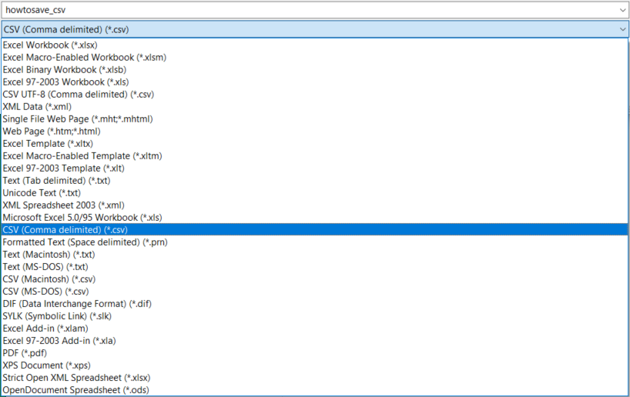

FINALLY! Getting data into R!
Import things as a .CSV if you can
This prevents issues by using a static file (i.e., no formulas)
(All databases allow export as .CSV)
You can import files in .XLS or .XLSX but it’s easier to use “flat” files
Use “read_csv()” from the package “tidyverse”
You may also see code online for read.csv()
X
Notes:
CSV, flat version of excel. Lacks formatting, highlights, colors, formulas. Universal format.

Slide 69

Reading in a file
Getting data into R is relatively simple! Use:
read_csv(“folderlocation/filename.csv”)
read_csv(“folderlocation\\filename.csv”)
NOT read_csv(“folderlocation\filename.csv”)
You must use a forward slash “/” or 2 back slashes “\\” to designate a folder or directory
This is different than the way Windows shows
Notes:
Forward slash or double backslash
Different on Mac. Folder locations given by Windows.

Slide 70

Reading in a file
Can I use the RStudio Import Wizard?
No.
Future you (or colleagues) will not know which file you chose.
Notes:
Can anyone tell me why this would be a bad idea?

Slide 71
SHOW ME THE DATA
OK so you have your data in. How can we look at it?
Type the name in console (shows first few rows/columns)
Type View(dataframe_name) or click on the dataframe name in the top right pane (shows same thing).
Once opened, you can now filter, sort, scroll, etc.
Check structure: str(dataframe_name) , glimpse(dataframe_name)
summary(dataframe_name) to see info about dataframe

Slide 72
Your turn 3
Navigate the Your turn 3 in the DataManipulation.Rmd
We will go over reading in the data together
Work through some examples of using dplyr functions to manipulate data to calculate summary statistics.
📑 use the dplyr cheat sheet or `?help` function in R 🤚feel free to ask any questions

Slide 73


Data Import
Simply importing the data is the easy part
What takes time is being thorough, so your data is:
Clean, tidy data;
Clearly named
Correct column “type”
Excuse me,
do you have a moment to speak about programming?
Notes:
OK that’s it! We had an entire section just around one single function!

Slide 74
Data Import
Analysis Checklist
Data is:
QA/QC’d
Flat file (.csv, etc.)
Not summarized
One row/observation
Make a new directory (folder) & RProject

Slide 75
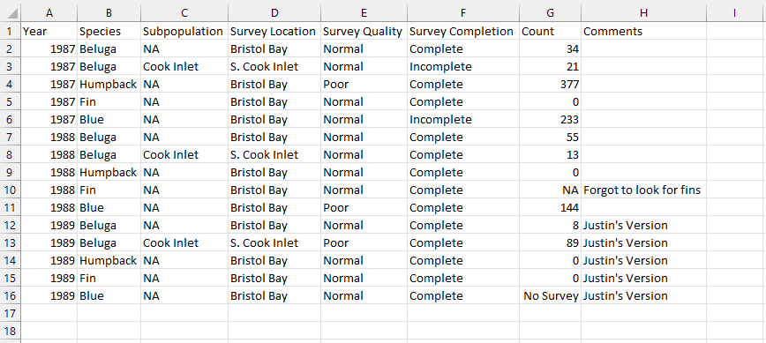
The most common data error
What is the problem here:
What does this do to this entire column??
Notes:
Multiple “data types in column G. Will read the entire column as a character instead of numeric.

Slide 76
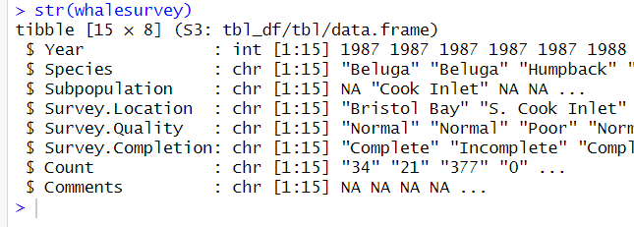
The most common data error
Always carefully check the structure of your data after importing
It is very common for words (text) to appear in a column of numbers
This makes the whole column of type “character”
str() shows type
Notes:
Glimpse() also works to view data

Slide 77
Quiz 2
Which of these correctly reads a file “mydata.csv” from folder “data” into R?
a) readcsv(“data/mydata.csv”)
b) read_csv(“data/mydata.csv”)
c) read(“data/mydata.csv”)
d) read_csv(“data\mydata.csv”)
What are some ways we can see the data in RStudio after import?
a) Click dataframe name in top right pane “Environment”
b) View(dataframename)
c) Type dataframename into console
QUIZ!

Slide 78
Quiz 2
Which of these correctly reads a file “mydata.csv” from folder “data” into R?
a) readcsv(“data/mydata.csv”)
b) read_csv(“data/mydata.csv”)
c) read(“data/mydata.csv”)
d) read_csv(“data\mydata.csv”)
What are some ways we can see the data in RStudio after import?
a) Click dataframe name in top right pane “Environment”
b) View(dataframename)
c) Type dataframename into console
QUIZ!

Slide 79
Quiz 2 - BONUS
Which of these correctly reads a file “mydata.csv” from folder “data” into R?
a) readcsv(“data/mydata.csv”)
b) read_csv(“data/mydata.csv”)
c) read(“data/mydata.csv”)
d) read_csv(“data\mydata.csv”)
What are some ways we can see the data in RStudio after import?
a) Click dataframe name in top right pane “Environment”
b) View(dataframename)
c) Type dataframename into console
QUIZ!
Why did each of these fail??? Let’s discuss
Notes:
A and B function name spelled incorrectly
D forward slash instead of backslash. Either one forward slashes or two backslashes

Slide 80



Error Are Puzzles not Problems
Importing data into R often brings errors or unexpected issues.
Let’s chat about errors and reframe them as puzzles
Every error has a message and there are clues in it!

Slide 81
Errors – Don’t Fret!
It is VERY normal to get errors every other line starting out
DO NOT WORRY
Error messages are just a clue to get your code closer to running
Don’t Worry
Be Happy

Slide 82

Some Common Errors
Misspelling variable/function
Not ending a line in parenthesis, comma, etc.
Unpaired parentheses/quotes
Capitalizing vs no caps
Not loading package before calling function
Wrong data type is used
RStudio will help minimize these!
Experience, going slow & thorough minimizes these!
Notes:
Rstudio will help flag some of these errors.

Slide 83

Error Clues – Let’s solve together
Error: Solution:
unexpected symbol / constant
> summary(c(1, 2, 4) digits = 2) Error: unexpected symbol in "summary(c(1, 2, 4) digits"
Check for commas, parentheses
> mean(c(1,2 4))
Error: unexpected numeric constant in "mean(c(1,2 4"
could not find function
Review spelling;
Need to load package
> red.csv("data/thedudeabides.csv") Error in red.csv("data/thedudeabides.csv") : could not find function "red.csv"
No such file or directory
> read.csv("data/thedudeabides.csv") Error in file(file, "rt") : cannot open the connection In addition: Warning message: In file(file, "rt") : cannot open file 'data/thedudeabides.csv': No such file or directory
Filename misspelled or folder misnamed
Notes:
Missing comma between c() and digits,
Missing comma after number
Mispelled function name, maybe package isn’t loaded yet
Mispelled file name, not in the correct directory.

Slide 84

Embrace the Error
Errors don’t go away, you just get faster at solving them
Notes:
Copy paste into google!

Slide 85
Quiz 3
BUG HUNTER: Each of these lines of code give an error. Find the error!
a) readcsv(“data/mydata.csv”)
b) mean(c(1, 2 3))
c) Summary(c(1, 2, 3))
d) mean(c(1, 2, 3 ,4)))
Errors are:
a) A massive problem
b) Puzzles to solve
c) Frequent
Clues containing hints
Common for all coders
QUIZ!

Slide 86
Quiz 3
BUG HUNTER: Each of these lines of code give an error. Find the error!
a) read_csv(“data/mydata.csv”)
b) mean(c(1, 2, 3))
c) summary(c(1, 2, 3))
d) mean(c(1, 2, 3 ,4)))
Errors are:
a) A massive problem
b) Puzzles to solve
c) Frequent
Clues containing hints
Common for all coders
QUIZ!

Slide 87
Tell R where to go! (SET Directory Location)
Use setwd() to set your directory to different than default
Not needed when using Rprojects!

Slide 88
Error Summary Table – Reference
Error Message | Possible Problem
unexpected symbol in ____ | You made a syntax (coding grammar) error (extra comma, parenthesis, etc.)
could not find function | You forgot to load a package or misspelled the function name.
cannot open file .* : No such file or directory | You tried a path that doesn't exist.
there is no package called ___ | You forgot to install a package or misspelled the package name
object .* not found | The object you are looking for might not exist.
non-numeric argument to ___ | You tried to use a character vector where a numeric is needed.
attempt to apply non-function | You tried to use an object which is not a function as a function.
object of type 'closure' is not subsettable | You called `$` on a function.
More common
Less common
Based on https://github.com/colinfay/argh
Notes:
Don’t memorize this list! Instead use it as a reference to come back to.
These are somewhat organized from the error messages that you’ll see today to those that are a little more obscure

Slide 89


Data Review
Yay! You’re almost ready to import data!
A couple of items to note about your data to save time in the long run:
Data DO! | Data DON’T
Use raw data (straight from database if possible) | Don’t summarize data before importing
Use “tidy” data | Don’t use data that is “tabled”
DB
Notes:
Before getting your data in, you will need to make sure that it is “machine readable”
Using R and the tidyverse will make you better with your data. While Excel is great for many things, especially quickness, it allows for bad habits. For example, it will let you combine different types of data into the same column (a column for “Length” can include 100, TRUE, “No sample here”; this is a massive data issue).

